Slide 1

Sorting

Slide 2
In-memory Sort: Quick Sort
pick one element in the array, which will be the pivot.
make one pass through the array, called a partition step, re-arranging the entries so that:
the pivot is in its proper place.
entries to the left of the pivot are smaller than the pivot
entries to its right are larger than the pivot
Detailed Steps:
Starting from left, find the item that is larger than the pivot,
Starting from right, find the item that is smaller than the pivot
Switch left and right
recursively apply quicksort to the part of the array that is to the left of the pivot, and to the part on its right.
1st pass: pivot = 18
18
5
6
19
3
1
5
6
11
21
33
23
left
right
O(n log n) on average, worst case is O(n²)

Slide 3
External Sorting
Sort 1Gb of data with 1Mb of RAM?
Why not just using virtual memory?
1st pass: pivot = 18
18
5
6
19
3
1
5
6
11
21
33
23
left
right
Notes:
4

Slide 4
2-Way Sort: Requires 3 Buffers
Pass 1: Read a page, sort it, write it
only one buffer page is used
INPUT 1
Disk
Disk
Main memory buffers
Pass 2, 3, …, etc.:
three buffer pages used.
INPUT 1
Disk
OUTPUT
Disk
INPUT 2
Main memory buffers
Notes:
5

Slide 5
Two-Way External Merge Sort
Each pass we read + write each page in file.
N pages in the file => the number of passes
So total cost is:
Idea: Divide and conquer: sort subfiles and merge
3,4
6,2
9,4
8,7
5,6
3,1
2
Input file
PASS 0
3,4
2,6
4,9
7,8
5,6
1,3
2
1-page runs
PASS 1
2,3
4,7
1,3
2-page runs
4,6
8,9
5,6
2
PASS 2
2,3
4,4
1,2
4-page runs
6,7
3,5
8,9
6
PASS 3
1,2
2,3
3,4
8-page runs
4,5
6,6
7,8
9
Notes:
6

Slide 6
Two-Phase Multi-Way Merge-Sort
More than 3 buffer pages. How can we utilize them?
Phase 1:
Fill all available main memory with blocks from the original relation to be sorted.
Sort the records in main memory using main memory sorting techniques.
Write the sorted records from main memory onto new blocks of secondary memory, forming one sorted sublist. (There may be any number of these sorted sublists, which we merge in the next phase).
Sorted f1
MM
Sorted f2
File to be sorted
:
Sorted fn

Slide 7
Phase 2: Multiway Merge-Sort
Merge all the sorted sublists into a single sorted list.
Partition MM into n blocks
Load Fi to block i
Pointers to first unchosen records
Select smallest unchosen key from the list for output
Output buffer
Input buffer, one for each sorted list
Done in main memory

Slide 8
Phase 2: Multiway Merge-Sort
Find the smallest key among the first remaining elements of all the lists. (This comparison is done in main memory and a linear search is sufficient. Better technique can be used.)
Move the smallest element to the first available position of the output block.
If the output block is full, write it to disk and reinitialize the same buffer in main memory to hold the next output block.
If the block from which the input smallest element was taken is now exhausted, read the next block from the same sorted sublist into the same buffer.
If no block remains, leave its buffer empty and do not consider elements from that list.

Slide 9
Memory Requirement for Multi-Way Merge-Sort
Partitioning Phase:
Given M pages of main memory and a file of |f| pages of data, we can partition the file into |f|/M small files.
MM
Sorted f1
File to be sorted
Sorted f2
:
Sorted fn
Merge Phase:
At least M-1 pages of main memory are needed to merge |f|/M sorted lists, so we have M-1>=|f|/M, i.e., M(M-1)>=|f|.
INPUT 1
INPUT 2
OUTPUT
INPUT n
Main memory buffers
Disk
Disk

Slide 10
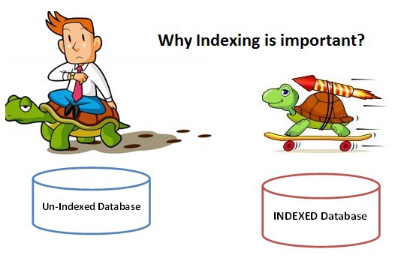
Indexing

Slide 11
Motivation Example
Consider a file of Students (name, gpa) records sorted by gpa
Suppose the data file has 4 data pages.
Search for students whose gpa = 2.2
Here gpa is called “search key”
With binary search, how many pages need to be accessed?
S1, 2.0
S2, 2.2
S3, 2.3
S4, 2.4
S5, 2.4
S6, 2.5
S7, 2.6
S8, 2.7
S9, 2.7
S10, 3
P1
P2
P3
P4
P5
data page
data file: all data pages

Slide 12
How about indexing
Consider a file of Students (name, gpa) records sorted by gap
Suppose there are 4 pages.
Search for students whose gpa >2.6
With binary search, how many pages need to be accessed?
Index page, which stores a number of entries, each being in the form of <search key value, page id>
2.0
2.2
2.3
2.4
2.4
2.5
2.6
2.7
2.7
3.0
A, 2.0
M, 2.2
C, 2.3
L, 2.4
P, 2.4
D, 2.5
E, 2.6
F, 2.7
X, 2.7
Y, 3
P1
P2
P3
P4
P5
Index page and data page are of the same size
Index page can hold a lot more entries than data page
Index page stores only the values of one attribute
Data page stores the values of whole record

Slide 13
When records are sorted, indexing can be dense or sparse
Dense indexing: Every record has one index entry
2.0
2.2
2.3
2.4
2.4
2.5
2.6
2.7
2.7
3.0
A, 2.0
M, 2.2
C, 2.3
L, 2.4
P, 2.4
D, 2.5
E, 2.6
F, 2.7
X, 2.7
Y, 3
P1
P2
P3
P4
P5
Sparse indexing: Usually one page has only entry
2.0
2.3
2.4
2.6
2.7
A, 2.0
M, 2.2
C, 2.3
L, 2.4
P, 2.4
D, 2.5
E, 2.6
F, 2.7
X, 2.7
Y, 3
P1
P2
P3
P4
P5

Slide 14
When records are not sorted (i.e., unclustered), indexing must be dense – every record must have an entry in the index file
2.0
2.2
2.3
2.4
2.4
2.5
2.6
2.7
2.7
3.0
A, 2.0
L, 2.4
C, 2.3
M, 2.2
E, 2.6
D, 2.5
P, 2.4
Y, 3
X, 2.7
F, 2.7
P1
P2
P3
P4
P5

Slide 15
Quick Review
Index page and data page are of the same size
Index page can hold a lot more entries than data page
Index page stores only the values of one attribute
Data page stores the values of whole record
Dense/sparse
Cluster/uncluser

Slide 16
Index Sequential Access Method (ISAM)

Slide 17
An Example of ISAM tree

Slide 20
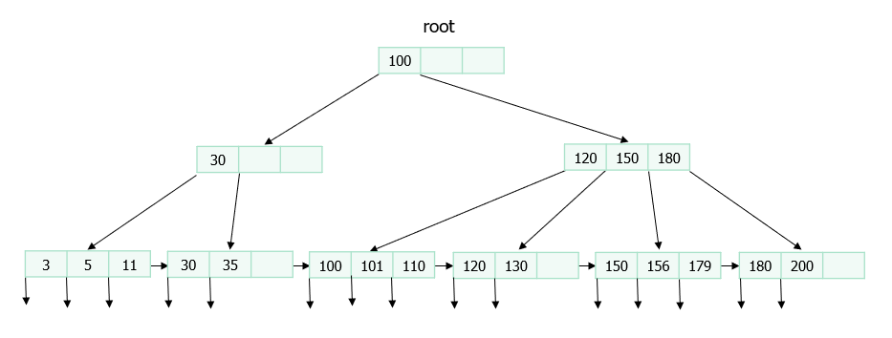
Two types of index node
A directory node stores a set of index entries, each linking to another index node
A data entry node or a set of data entries, each linking to a data record or a data node (or data page)
The data entry nodes are chained to form a sequence
The entries in an index node are sorted
A data node stores a set of records, which may or may not be sorted
B⁺-Tree
Employee Number, Company
directory node
index node
data entry node
3, A
101, B
4, C
data node
data page
record page
119, E
2, X
115, Y
Notes:
a data file is a sequence of pages, each storing a number of records

Slide 21
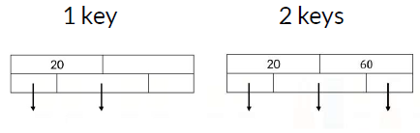
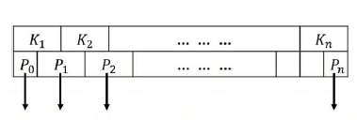
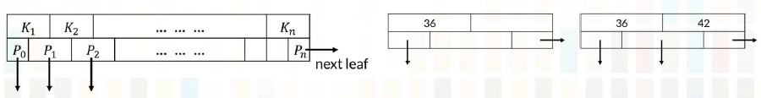
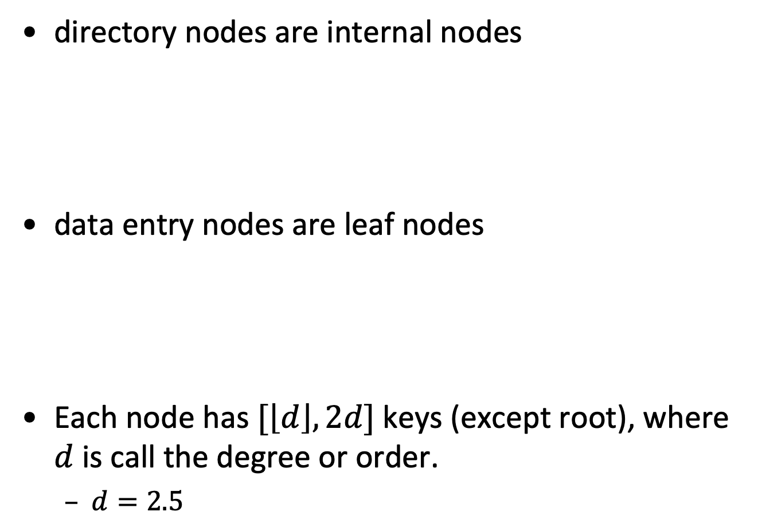
B+ Tree Nodes Zoom In
directory nodes are internal nodes
data entry nodes are leaf nodes
Each node has $[\left\lfloor d\right\rfloor , 2d]$keys (except root), where $d$ is call the degree or order.
$d=2.5$

Slide 22
Paged-tree: each node takes a whole page
For an index node, a page stores n keys and n+1 pointers, where n is the largest number subject to
n * SearchKeySize + (n+1) * PointerSize <= PageSize
For a data node, a page stores m records, where m = PageSize/RecordSize
B⁺-tree is featured being short (usually 3 or 4 layers) and fat (with a large number of fanouts)
B⁺-Tree
Employee Number, Company
index node
directory node
data entry node
Search key
3, A
101, B
4, C
data node
data page
record page
119, E
2, X
115, Y
Notes:
a data file is a sequence of pages, each storing a number of records

Slide 23
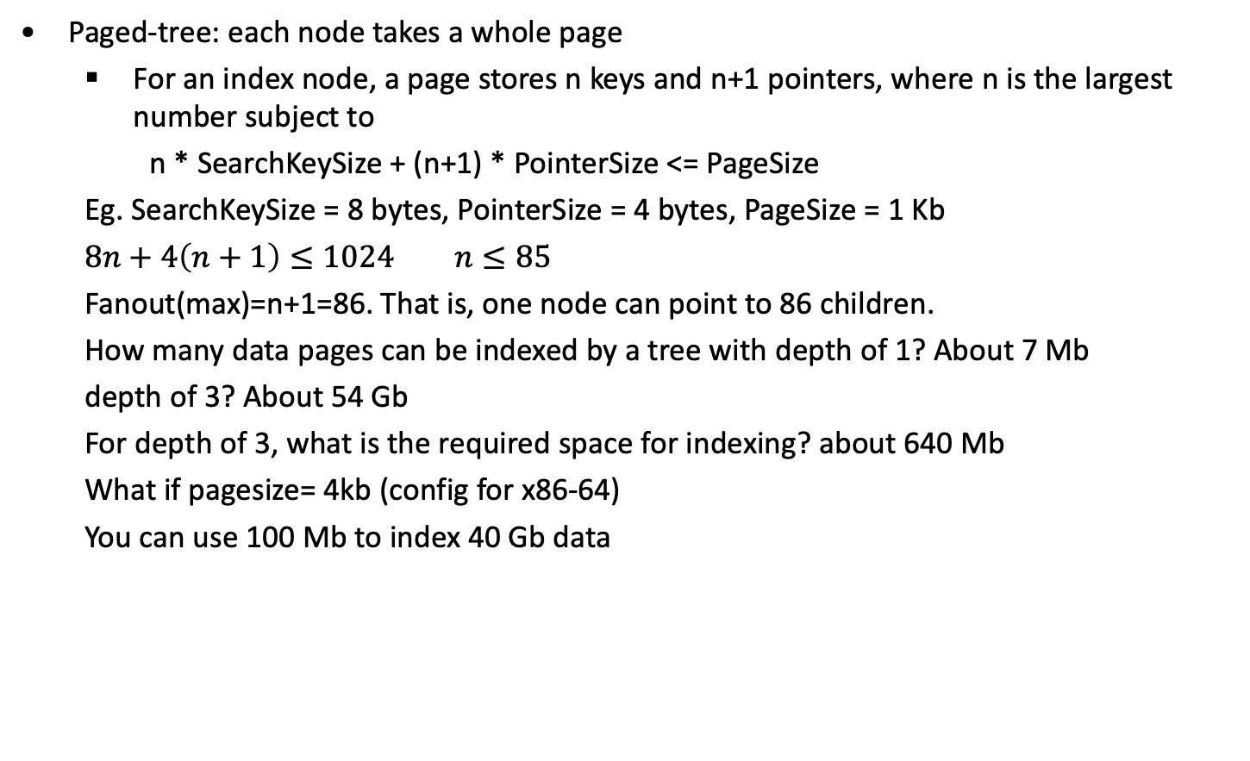
B⁺-Tree
Paged-tree: each node takes a whole page
For an index node, a page stores n keys and n+1 pointers, where n is the largest number subject to
n * SearchKeySize + (n+1) * PointerSize <= PageSize
Eg. SearchKeySize = 8 bytes, PointerSize = 4 bytes, PageSize = 1 Kb
$8n+4\left(n+1\right)≤1024$ $n≤85$
Fanout(max)=n+1=86. That is, one node can point to 86 children.
How many data pages can be indexed by a tree with depth of 1? About 7 Mb
depth of 3? About 54 Gb
For depth of 3, what is the required space for indexing? about 640 Mb
What if pagesize= 4kb (config for x86-64)
You can use 100 Mb to index 40 Gb data
Notes:
86*86=7396 kb about 7 Mb
86^4 about 54 Gb
86^3 + 86*86 + 86+ 1= about 640 Mb
What if pagesize= 4kb (config for x86-64)
$8n+4\left(n+1\right)≤1024$*4
N=341
Fanout=342
Depth 1
342^2 over 100 Mb
Depth 2
342^3 about 40 Gb

Slide 24
Equality Search
Start from the root, find the pointer whose left key and right key values contains the search key value
Follow the pointer to the linked node, repeat until reaching a data node
Search the records in the data node and return those that match
Range search (similar procedure)
B⁺-Tree
Employee Number, Company
index node
directory node
data entry node
Search key
3, A
101, B
4, C
data node
data page
record page
119, E
2, X
115, Y
Notes:
a data file is a sequence of pages, each storing a number of records

Slide 25
Insert a record with a key value of k
Search the data entry node that contains k
Insert the record to the linked data node
The insertion may cause the data node to full, in which case the data node is split
The split may propagate up, causing the root node to split, in which case a new root is created
Delete (reverse process of Insert)
B⁺-Tree
Employee Number, Company
index node
directory node
data entry node
Search key
3, A
101, B
4, C
data node
data page
record page
119, E
2, X
115, Y
Notes:
a data file is a sequence of pages, each storing a number of records

Slide 26
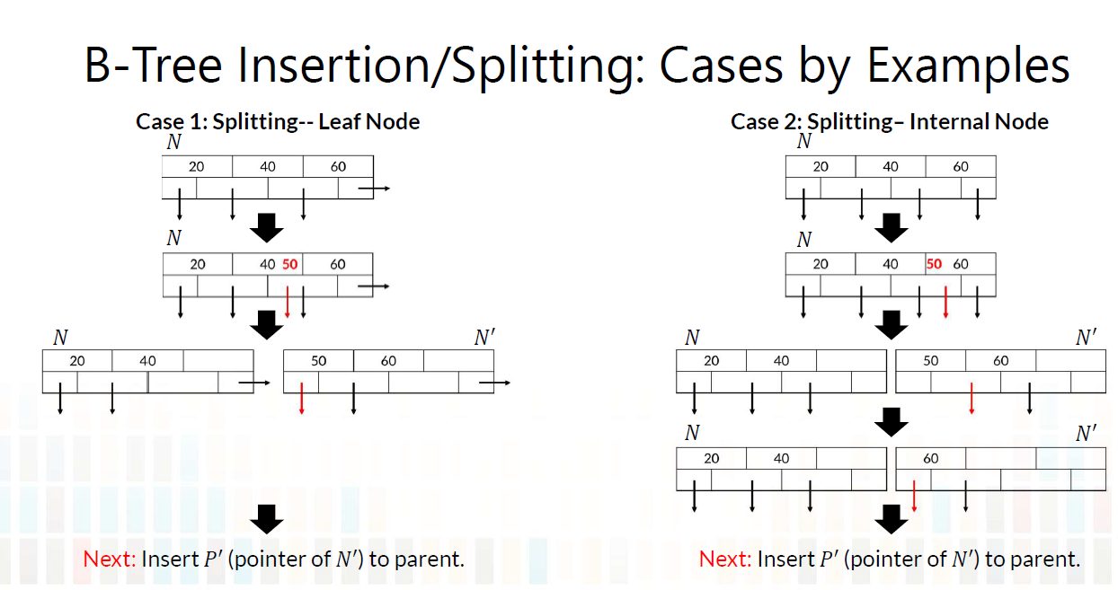

Slide 27
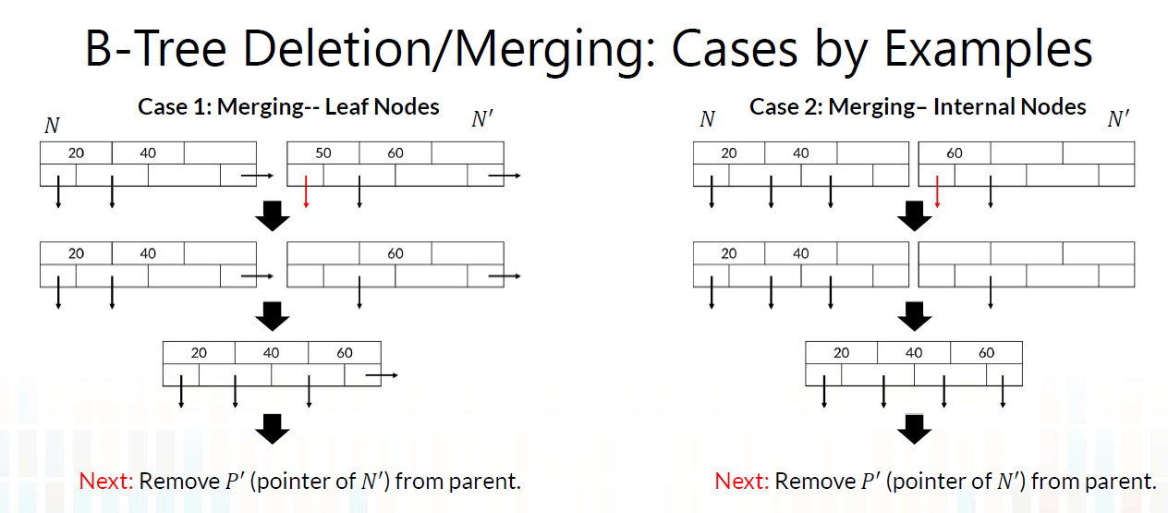

Slide 28
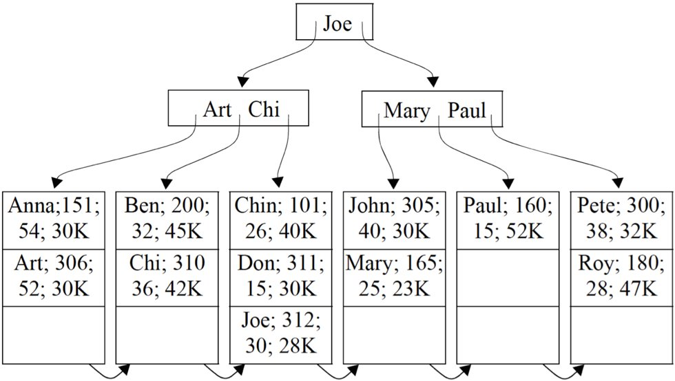
B⁺-Tree: Another example
index node
Index entries , each linking to index node
Name; weight;
Age; Income
Data Entries, each linking to a record or a data page
Data node
Data
record
Notes:
a data file is a sequence of pages, each storing a number of records

Slide 29
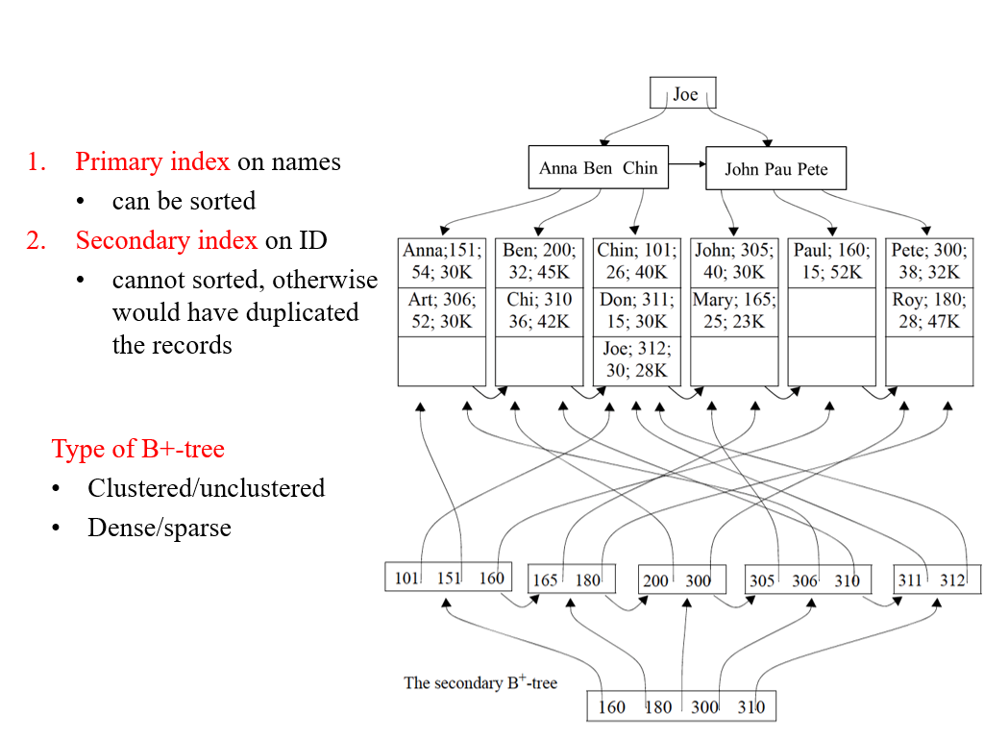
Primary index on names
can be sorted
Secondary index on ID
cannot sorted, otherwise would have duplicated the records
Type of B+-tree
Clustered/unclustered
Dense/sparse

Slide 30
Dense or Sparse
DENSE INDEX
SPARSE INDEX
Index entries
direct search for
data entries
Data entries
Data entries
(Index File)
(Data file)
Data Records
Data Records
Dense: At least one data entry per data record
Sparse: At least one data entry per block/page
Pros and Cons:
Dense: less space-efficient, but great for both equality and range search
Sparse: more space-efficient, but need sequential search within a page

Slide 31
Clustered or Unclustered
CLUSTERED INDEX
UNCLUSTERED INDEX
Index entries
direct search for
data entries
Data entries
Data entries
(Index File)
(Data file)
Data Records
Data Records
Clustered Index :
The ordering of data records is organized the same as or close
to the ordering of data entries in the index
Sparse index is always clustered, e.g., alternative 1 can be regarded as sparse (why?)
A clustered index does not have to be sparse (why?)
Pros and Cons:
Clustered: maintenance cost high, but great for range search
Unclustered: low maintenance cost, but high retrieval cost
Retrieving one record may need to load one page

Slide 32
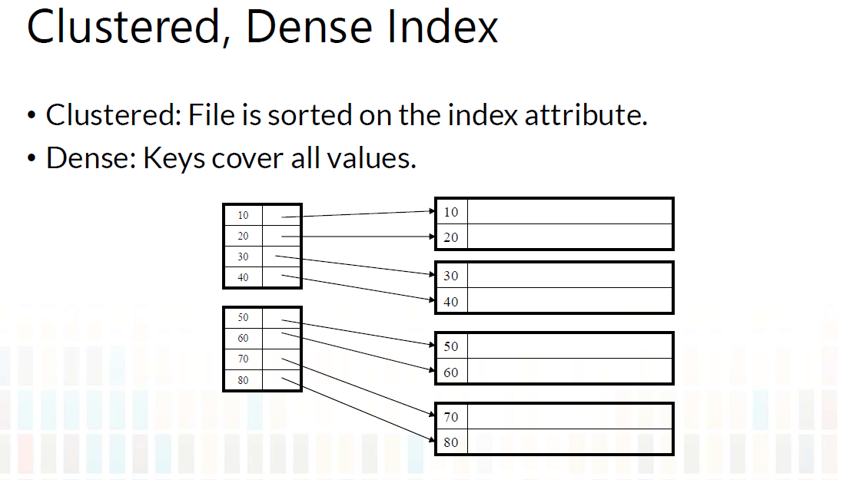

Slide 33
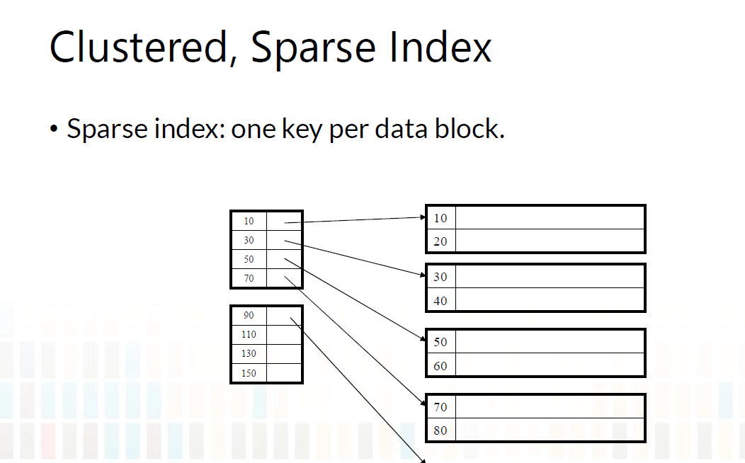

Slide 34
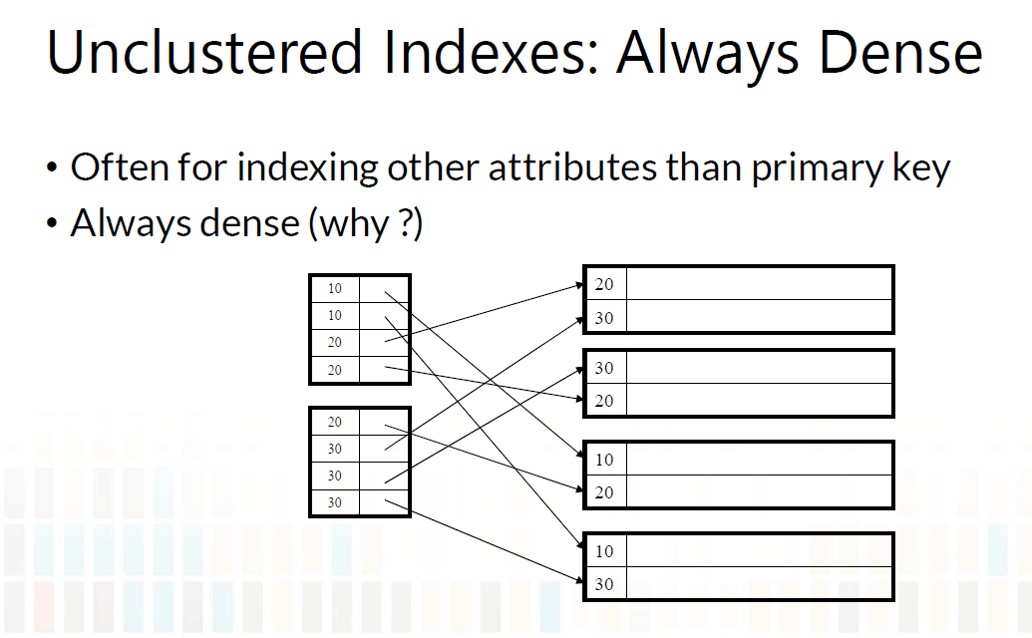

Slide 35

Hash-based Index

Slide 37
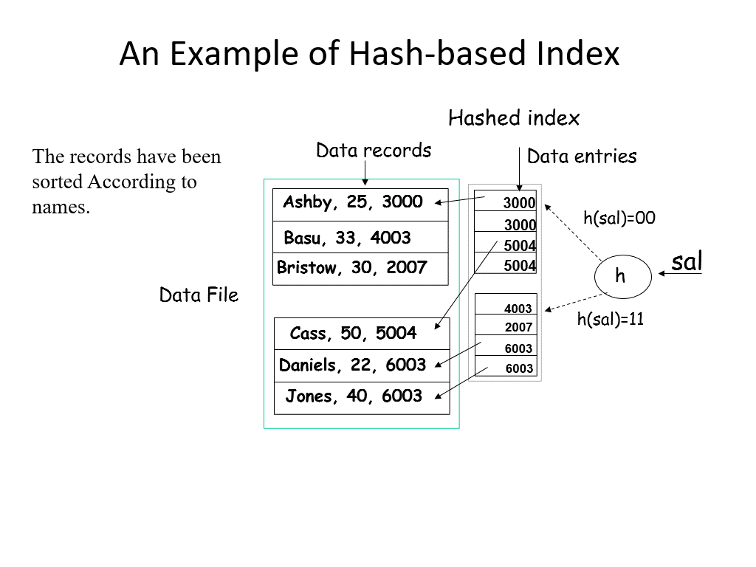

Slide 38
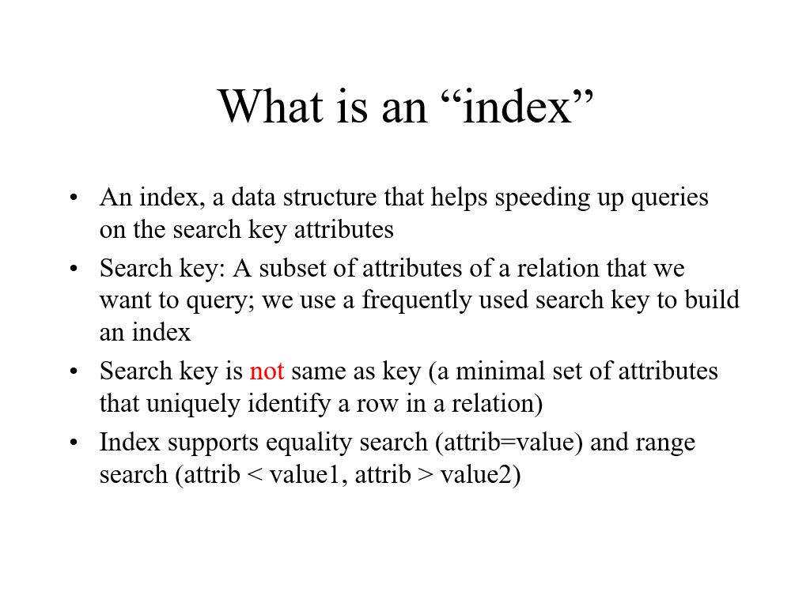
An Example of Hash-based Index
Hashed index
The records have been sorted According to names.
Data records
Data entries
Ashby, 25, 3000
3000
3000
h(sal)=00
Basu, 33, 4003
5004
5004
sal
Bristow, 30, 2007
h
Data File
4003
h(sal)=11
Cass, 50, 5004
2007
6003
Daniels, 22, 6003
6003
Jones, 40, 6003

Slide 39
How to create/drop an index?
Use SQL statements below.
At least one attribute is needed per index.
Example:
CREATE INDEX idx_pname ON Persons (LastName, FirstName);
CREATE INDEX index_name ON table_name (column1, column2, ...);
Create an index named “idx_pname” using values from two attributes: LastName and FirstName of the table Persons.
DROP INDEX index_name ON tbl_name;
Example:
DROP INDEX idx_pname ON
Persons;
The order of the attributes specified in the create index statement is important for DBMS to select whether an index is considered in a query execution plan.
Remove the index idx_pname associated with the table Persons.

Slide 40
What happen when an index is created?
Example:
CREATE INDEX idx_lname ON Persons (LastName);
DBMS builds an index structure using the values of the attributes specified in the create index SQL statement. In the above example, the index is built based on the values of the attribute LastName.
DBMS stores the index name and the attributes in its system catalog.
The index structure is stored in a file on disk and is updated when the values of the indexed attribute are updated/deleted/inserted
Warning! Do not create unnecessary indexes because there are cost associating with updating index files when records are deleted, added, and updated.

Slide 41
When DBMS does not consider using indexes
1) When the indexed attribute is used inside a function. These functions are not the aggregate functions (min, max, …).
Ex: where month(posted_date) = 5
Even there is an index with posted_date as the first attribute, the index won’t get used since posted_date is inside a function month that extracts the value of month from the posted_date attribute

Slide 42
When DBMS does not consider using indexes (Cont’d)
2) When the indexed attribute is used in a where clause with wildcard matching
Ex: where name like '%John‘
3) When a query involves multiple attributes, but none of these attributes is the first attribute of any of the indexes associated with the relation.
4) When it is more expensive to use relevant indexes than other plans

Slide 43
Types of indexes
Tree-based indexes (ISAM index, B-Tree, B+Tree)
Hash-based indexes based on hashing
Inverted indexes (value, and pointer(s) to the rows that have the values) like an index at the back of a book.
Spatial indexes for points, regions (R-Tree and variants)
DBMS may choose to implement only some types of indexes. For example, MySQL implements B-Tree and B+Tree index.

